Slide 1
Bootcampers
Mid-Bootcamp project by Amir H.Ahmadzadeh

Slide 2
The question
What qualifications contribute to the successful employment of boot-camp graduates in related fields?

Slide 3



Steps
Data Collection
Exploratory Data Analysis
Hypothesis Testing
Boot-camps graduates were asked to fill in a survey.
To present a graphical overview of data distribution for different variables.
3 different hypothesis were tested to answer different parts of initial question.

Slide 4
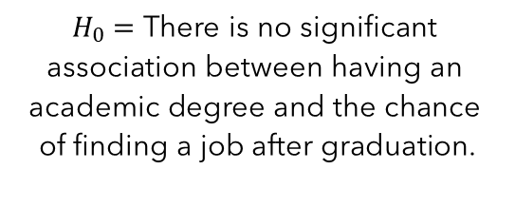
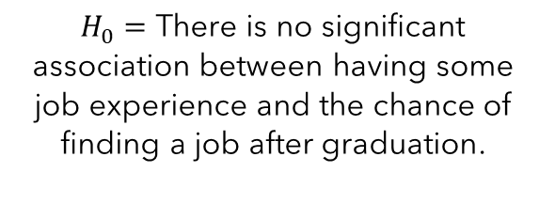
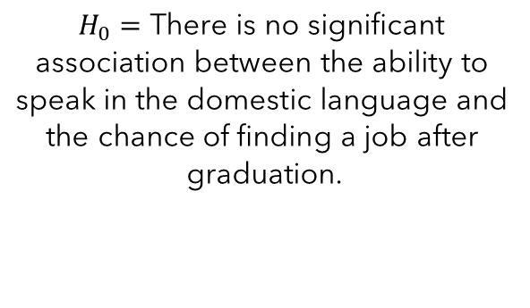
Null Hypotheses
job experience
Academic degree
Domestic language
$H_{0}$ $=\text{There} \text{is} \text{no} \text{significant} \text{association} \text{between} \text{having} \text{some} \text{job} \text{experience} \text{and} \text{the} \text{chance} \text{of} \text{finding} \text{a} \text{job} \text{after} \text{graduation}\text{. }$
$H_{0}$ $=\text{There} \text{is} \text{no} \text{significant} \text{association} \text{between} \text{having} \text{an} \text{academic} \text{degree} \text{and} \text{the} \text{chance} \text{of} \text{finding} \text{a} \text{job} \text{after} \text{graduation}\text{.}$
$H_{0}$ $=\text{There} \text{is} \text{no} \text{significant} \text{association} \text{between} \text{the} \text{ability} \text{to} \text{speak} \text{in} \text{the} \text{domestic} \text{language} \text{and} \text{the} \text{chance} \text{of} \text{finding} \text{a} \text{job} \text{after} \text{graduation}\text{.}$

Slide 5
Data collection
challenges
Target population
Come up with accurate and precise questions.
Find the potential targets
Time
Iron hack
Spiced
Berlin 42
questionnaire
Target population
Google forms
Multi state survey
Maximum of 22 questions
39 filed questionnaire
Raw csv file

Slide 6
EDA Exploratory Data Analysis
Participants
Hypothesis

Slide 7

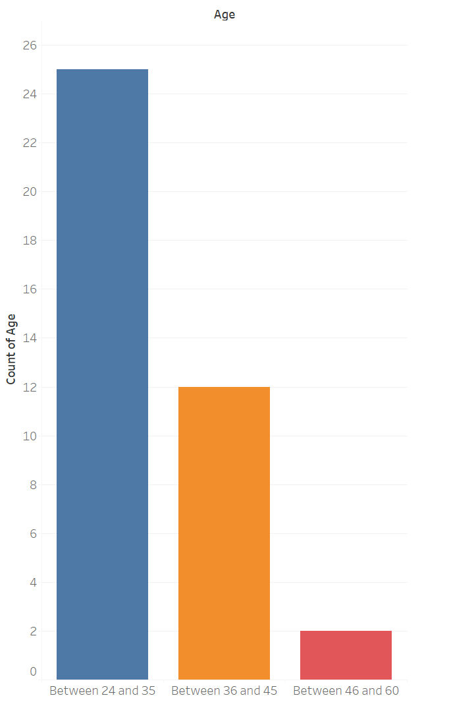

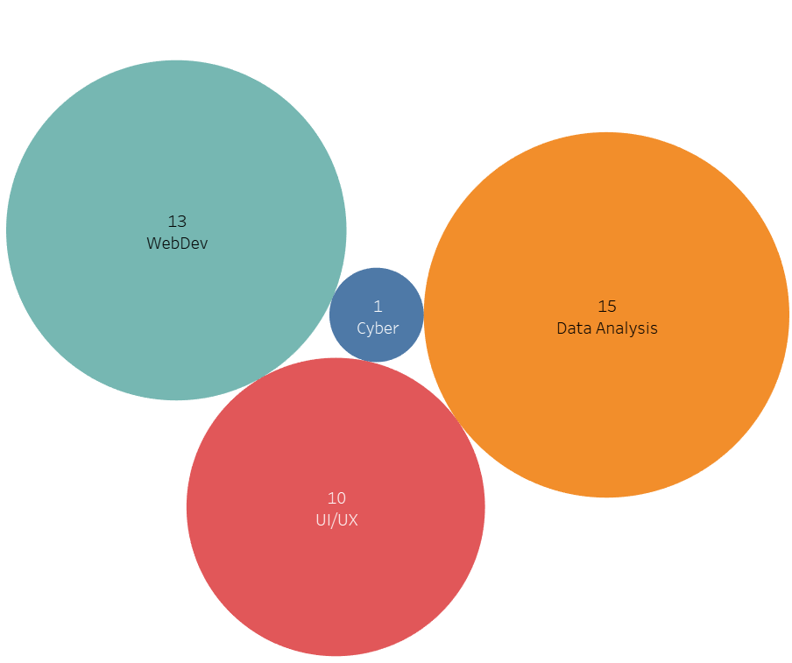
Participants

Slide 8
Participants…

Slide 9
Participants…

Slide 10
Participants…

Slide 11
Participants…

Slide 12
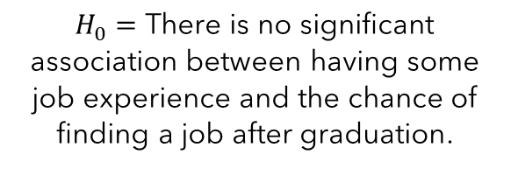
Hypotheses
job experience
Academic degree
Domestic language
$H_{0}$ $=\text{There} \text{is} \text{no} \text{significant} \text{association} \text{between} \text{having} \text{some} \text{job} \text{experience} \text{and} \text{the} \text{chance} \text{of} \text{finding} \text{a} \text{job} \text{after} \text{graduation}\text{. }$
$H_{0}$ $=\text{There} \text{is} \text{no} \text{significant} \text{association} \text{between} \text{having} \text{an} \text{academic} \text{degree} \text{and} \text{the} \text{chance} \text{of} \text{finding} \text{a} \text{job} \text{after} \text{graduation}\text{.}$
$H_{0}$ $=\text{There} \text{is} \text{no} \text{significant} \text{association} \text{between} \text{the} \text{ability} \text{to} \text{speak} \text{in} \text{the} \text{domestic} \text{language} \text{and} \text{the} \text{chance} \text{of} \text{finding} \text{a} \text{job} \text{after} \text{graduation}\text{.}$

Slide 13
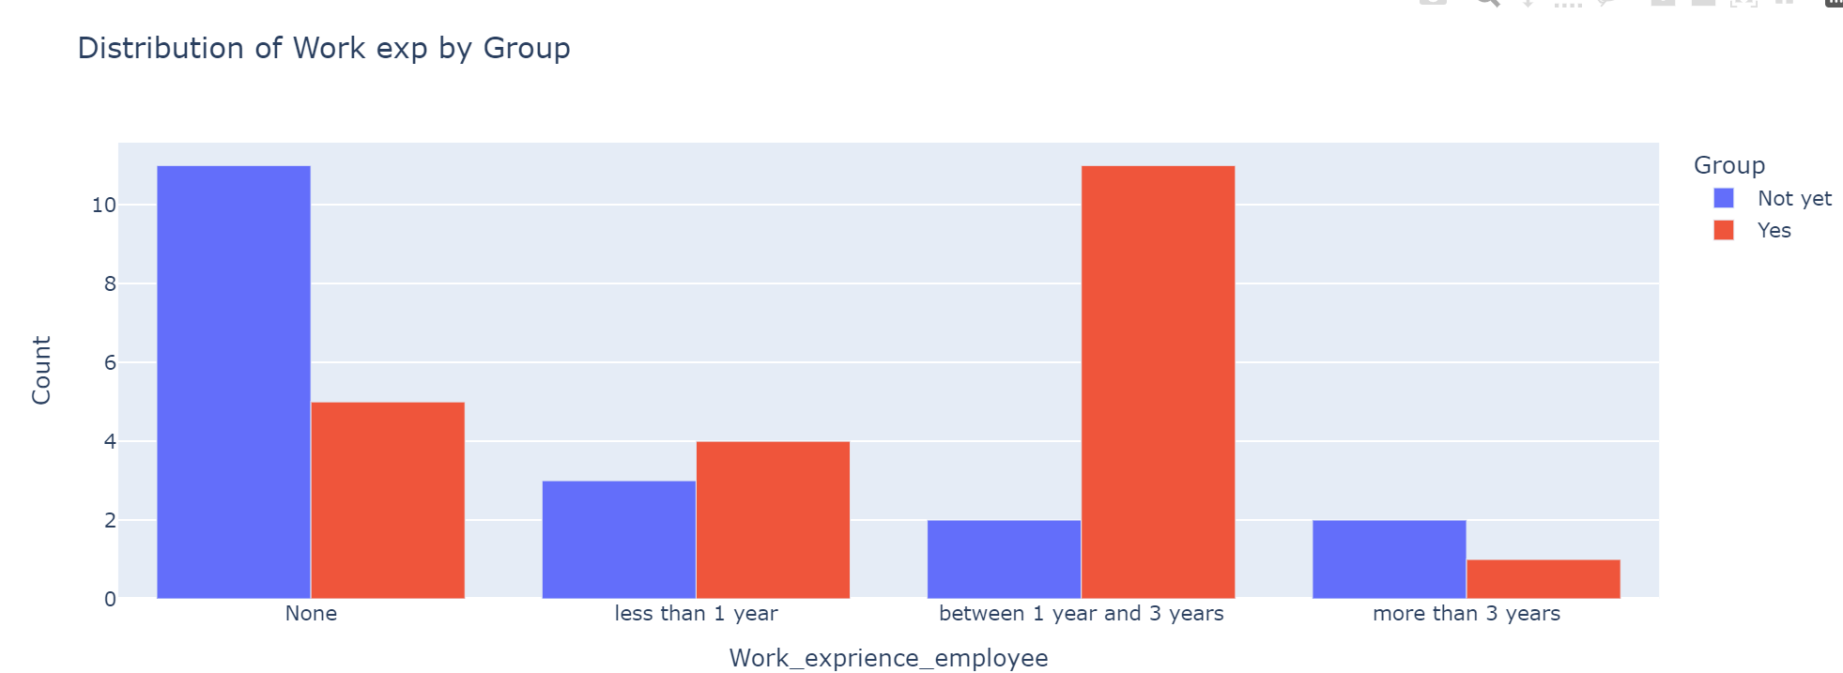
Hypothesis

Slide 14
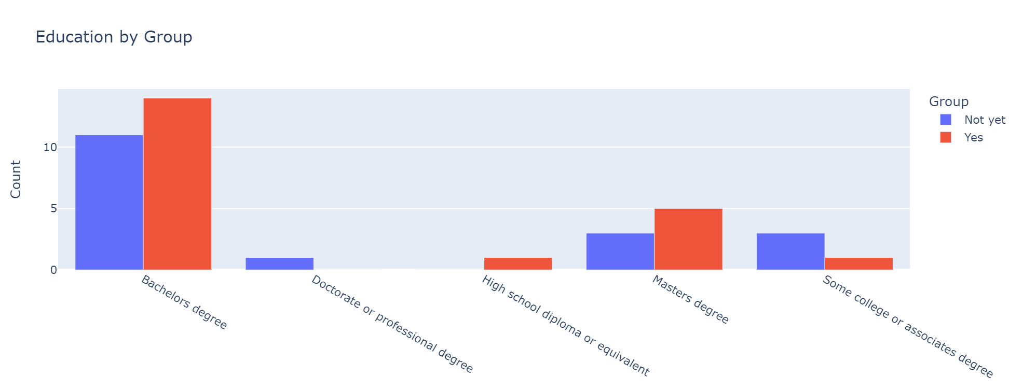
Hypothesis(…)

Slide 15
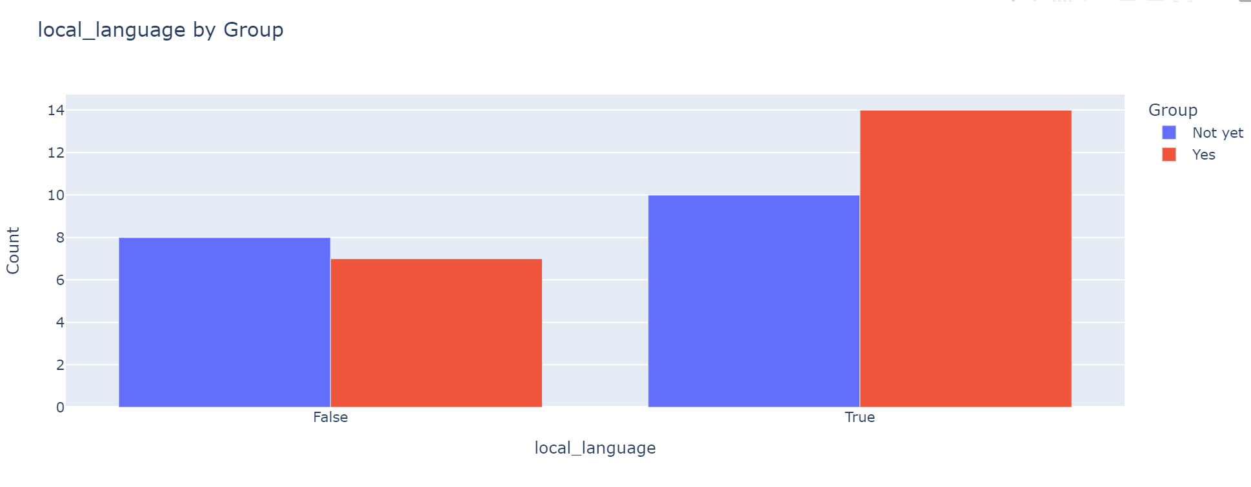
Hypothesis(…)

Slide 16
Hypothesis testing Exploratory Data Analysis
Population: All boot camp graduates who aimed to land a job after graduation
Sample: 39 participants in the survey
Two categorical variables
Employee( whether they found a job or not)
Work experience/Academic Degree/Speaking in the domestic language
Method: Chi-squared
Confidence interval = 0.95(p-value = 0.05)

Slide 17
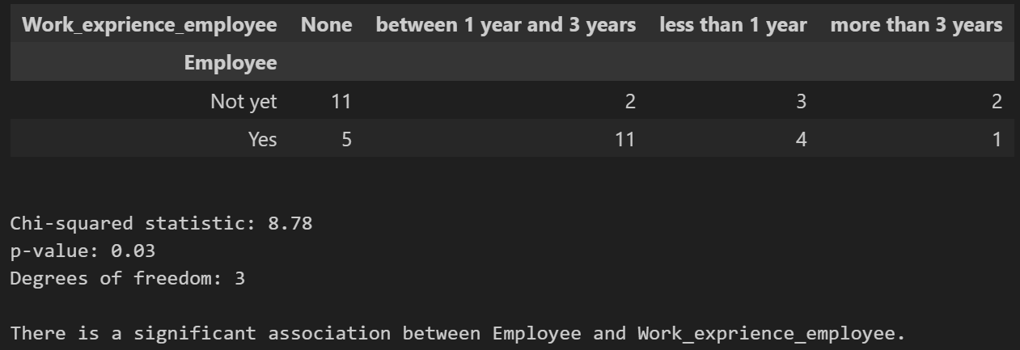
job experience
The null hypothesis is rejected, so it can be said that in 95% of cases, job experience even less than a year has a great impact on landing a job.

Slide 18
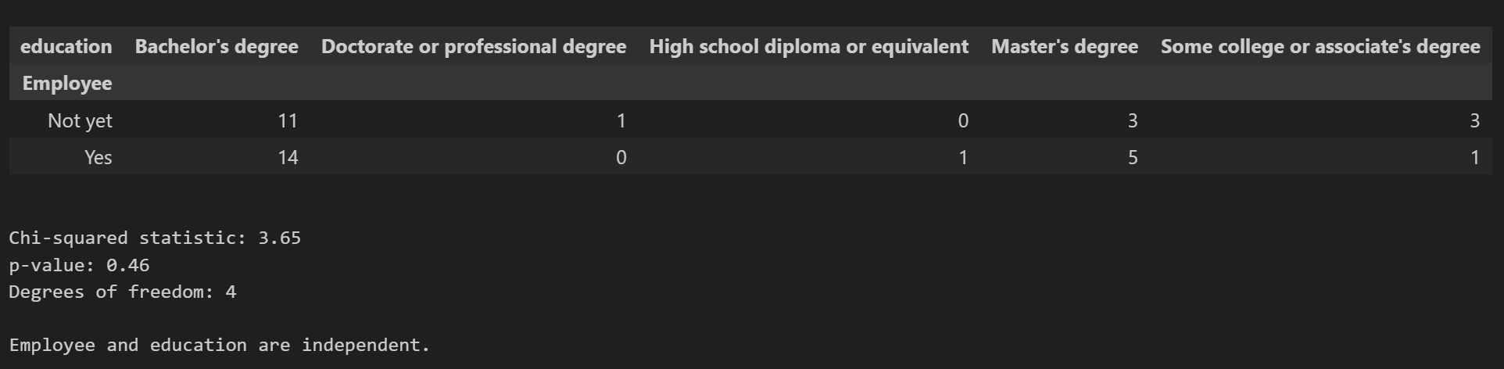
Academic degree experience
The null hypothesis can’t be rejected, so based on the sample at hand there is no dependency between the level of academic education and the chance of finding a job.

Slide 19
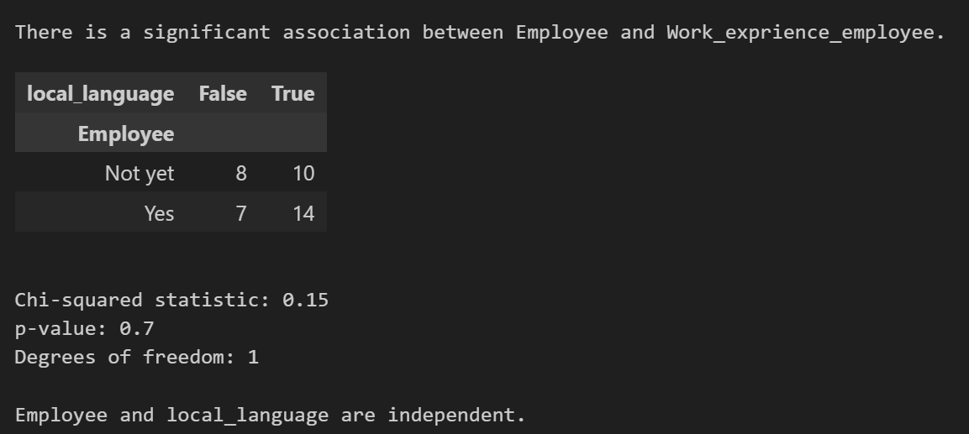
Domestic language
The null hypothesis can’t be rejected, so based on the sample at hand there is no dependency between the ability to speak in the domestic language and the chance of finding a job.

Slide 20
Potential Improvements
More data
Data visualization
Reperesentive sample

Slide 21
THANK YOU

